Slide 1




Coingeco
Project
By Andepu Daniel

Slide 2


Introduction
My objective was to gather data on the prices and various features of 100 crypto coins of your choosing spanning the last decade from the CoinGecko API. I was to store this data in a SQL database and use Power BI for analysis. My goal eventually was to derive insights that will inform my client's cryptocurrency investment decisions.

Slide 3


Top 10 Performing Coins
Bitcoin
Ethereum
Tether
BNB
Solana
USDC
XRP
Lido Staked Ether
Dogecoin
Toncoin
The Data Colection Process was don Using the Coingeco API through the Pycoingeco Library

Slide 4


Data Integrity
Inability to collect Historical Data due to limitations of the A.P.I
Challenges Faced
Innovation
I wasn’t able to successfully embed my Power BI dashboard into the slides, so I had to make due anyway
Time Constraints
The Process took too long which meant I could not turn in my project on time

Slide 5



Goals
To draw out useful business insights from the data in order to help clients make Informed Data-driven Decisions
01
02
03
04
Objective 01
Objective 02
Objective 03
Objective 04
Get Data.
Process and Store Data in SQL Database.
Synthesize Data and create visualizations.
Apply Insights to Business.

Slide 6


Code

Slide 7
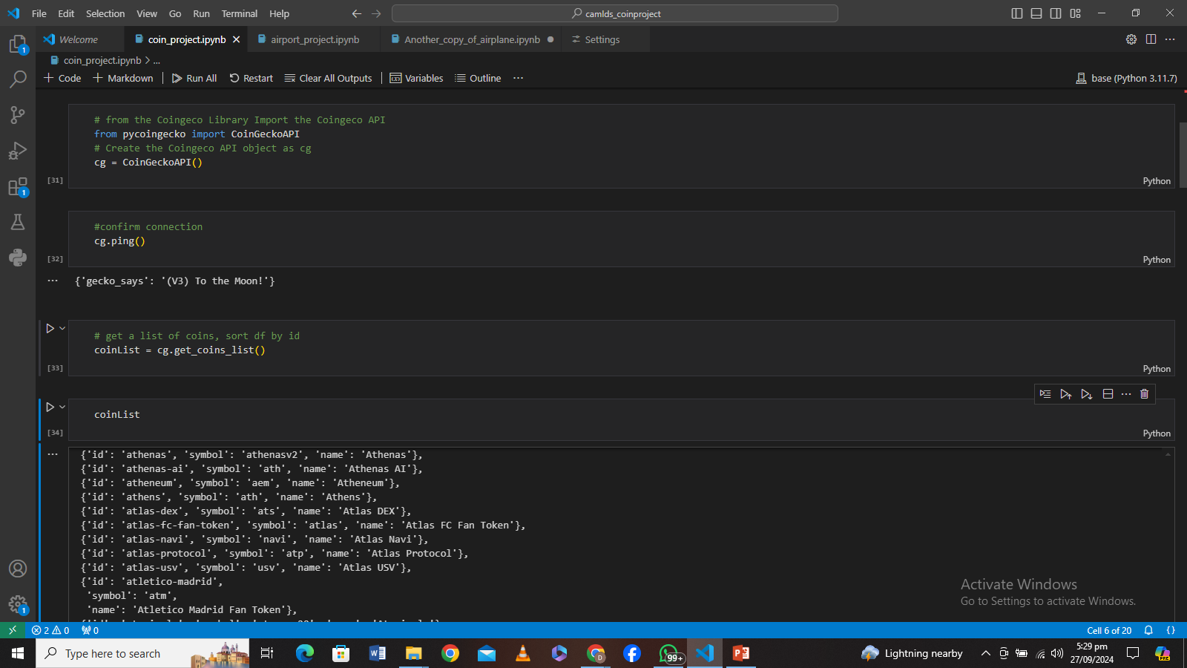
Code: Creating the Coingeco API object

Slide 8
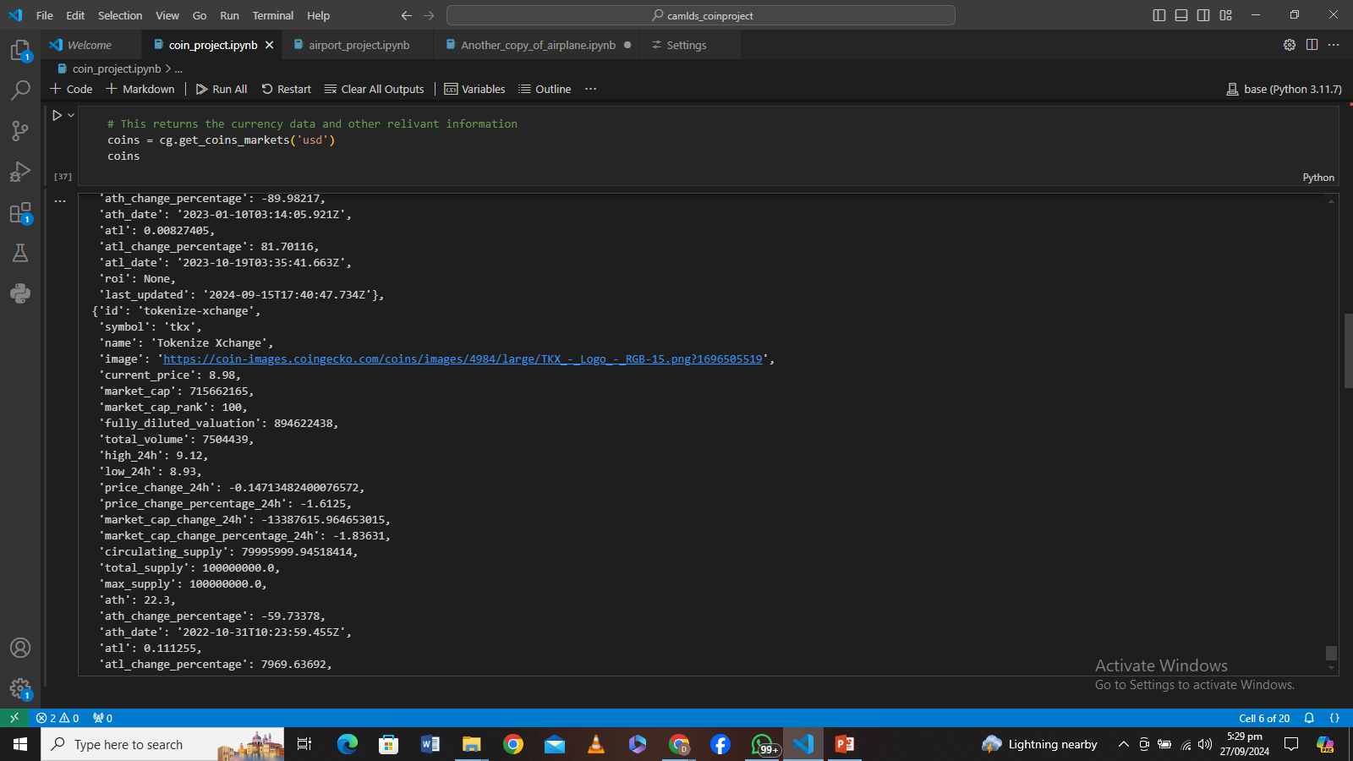
Code: Quoting the Coins against USD

Slide 9
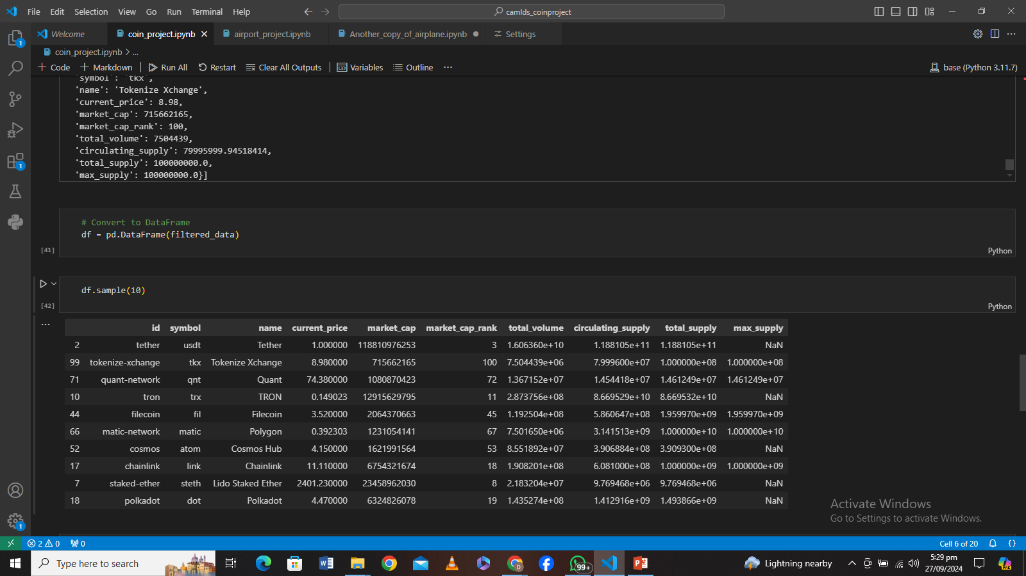
Code: Getting the top 10 coins from the List

Slide 10
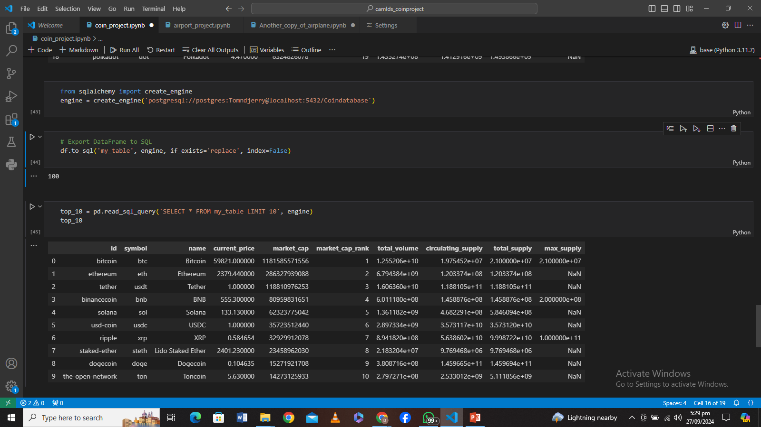
Code: Creating the SQL Table

Slide 11
Statistics

Slide 12


Statistics
Top 100
100
We Harvested the Top 100 coins from thecoingeco website through the Pycoingeco API
Top 10
10
Only 10 of the 100 cryptocurrencies were taken into account for the visualization.

Slide 13
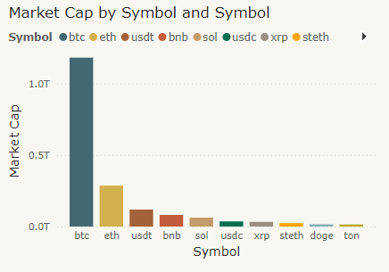
Ranking By Market Cap

Slide 14
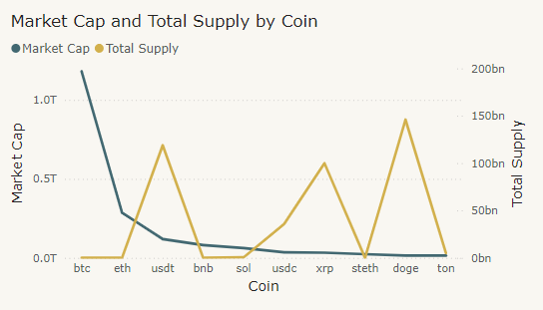
Relevant Relationships Between Values

Slide 15
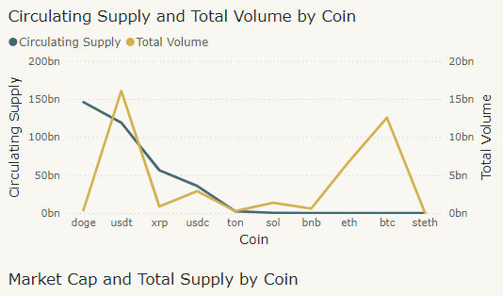
Relevant Relationships Between Values

Slide 16




Financial Report
Investment Decisions
From the Data I will recommend That my client Invest in more the following coins in the following order:
USDT
BTC
ETH
USDC
This is due to their high Volume on the open market and Ease of liquidation of assets if need be.

Slide 17






THANK YOU
For your time
Daniel Andepu
+234-808-461-8993
andepudaniel@gmail.com
AndepuD
Abuja, Nigeria

Slide 18

































Resource Page

